Slide 1
DIGITISED AND DECENTRALIZED BLOCKCHAIN TECHNOLOGY
TEAM-CS02
TEAM MEMBERS
Y.LAXMAN KARTHIK 21S11A6218
P.SANJEEV 21S11A6249
M.ABHINAV 21S11A6202
E.SANDHIPUDHU 21S11A6248
HOD OF CSE-CS UNDER GUIDANCE BY
MRS.T.SAI KUMARI Dr.VAKA MURALI MOHAN B.TECH,M.TECH,(PHD),MCSI PRINCIPAL OF MRITS

Slide 2
ABSTRACT
A purely peer-to-peer version of electronic cash would allow online payments to be sent directly from one party to another without going through a financial institution. Digital signatures provide part of the solution, but the main benefits are lost if a trusted third party is still required to prevent double-spending. We propose a solution to the double-spending problem using a peer-to-peer network. The network timestamps transactions by hashing them into an ongoing chain of hash-based proof-of-work, forming a record that cannot be changed without redoing the proof-of-work.

Slide 3
INTRODUCTION
Commerce on the Internet has come to rely almost exclusively on financial institutions serving as trusted third parties to process electronic payments.
While the system works well enough for most transactions, it still suffers from the inherent weaknesses of the trust based model. Completely non-reversible transactions are not really possible, since financial institutions cannot avoid mediating disputes.

Slide 4
EXISTING SYSTEM
Now a days the transactions are being processed using Cheques, Net Banking and payment Wallets. Payment wallet transactions involves third party of government.
These transactions allows centralized platform means power and rights are not to be equally distributed among all the participants in a system.
Performing transactions through Cheques, Net banking and payment Wallet Entail the receiver effectively authorizing the seller to “Pull” a payment from their account, passing through several financial intermediates in the process.
In this type 1of transaction, it is necessary to provide personal identification information such as your name and address and this type of transactions are stored physically in a wallet.

Slide 5
ADVANTAGES
Block chain transactions offers more security.
There is no need of documentation.
It is cost effective.
Unlimited transactions in a limited span of time.
No need of involvement of third party
DISADVANTAGES
These transactions offer less security.
There is a need of documentation.
Due to the involvement of third party there is a problem of “Double spending”.
It is not cost effective.

Slide 6
PROPOSED SYSTEM
In this project an electronic payment system based on cryptographic proof instead of trust, allowing any two willing parties to transact directly with each other without the need for a trusted third party.
Transactions that are computationally impractical to reverse would protect sellers from fraud, and routine escrow mechanisms could easily be implemented to protect buyers.
In this paper, we propose a solution to the double-spending problem using a peer-to-peer distributed timestamp server to generate computational proof of the chronological order of transactions.
The system is secure as long as honest nodes collectively control more CPU power than any cooperating group of attacker nodes

Slide 7
SYSTEM REQUIREMENTS
SOFTWARE REQUIREMENTS
Operating System : Windows 10
Python IDE : python 3.2.7,pycharm
HARDWARE REQUIREMENTS
RAM : 4GB and Higher
Processor : AMD Dual core processor
Hard Disk : 500GB Minimum

Slide 8
MODULES
Peer module
Block module
Transaction module
Chain module

Slide 9
MODULES DESIGN
Peer Module:
Used to create peers for the users involved in transaction
Block Module:
The created peers stored in blocks.
Transaction Module:
The users make transactions after validation of blocks.
Chain Module:
Then the valid blocks are added to the chain making transaction completes.

Slide 10
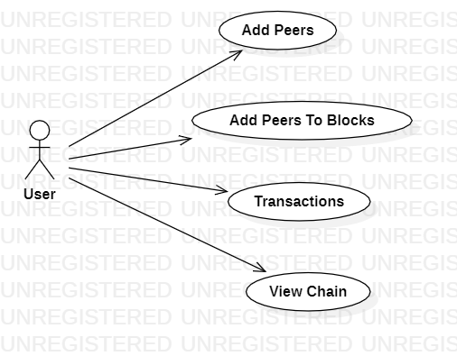
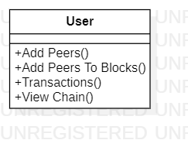
UML DIAGRAMS
Use Case Diagram
Class Diagram

Slide 11
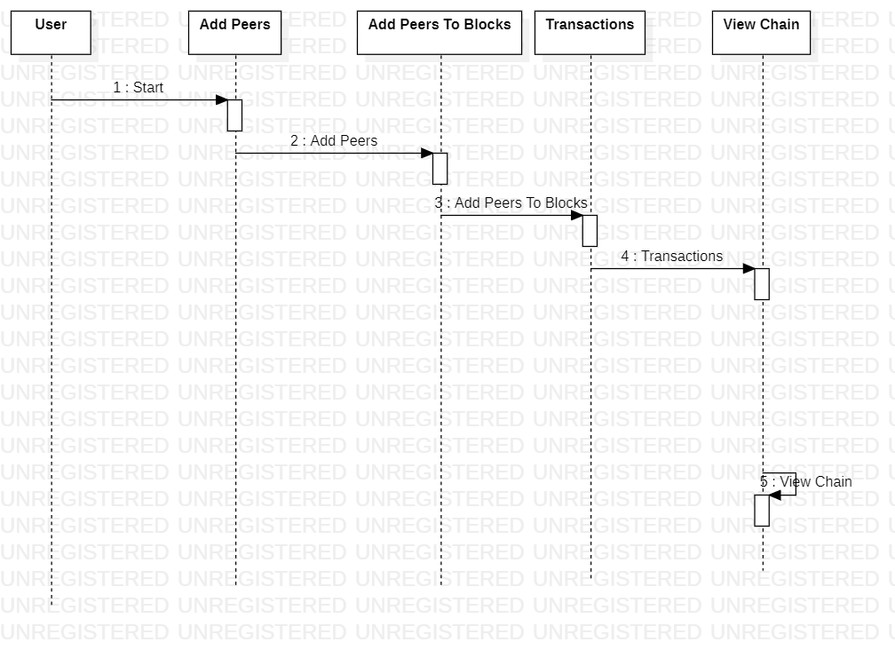
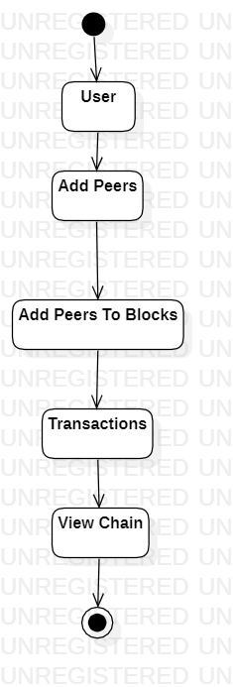
Sequence Diagram
Activity Diagram

Slide 12
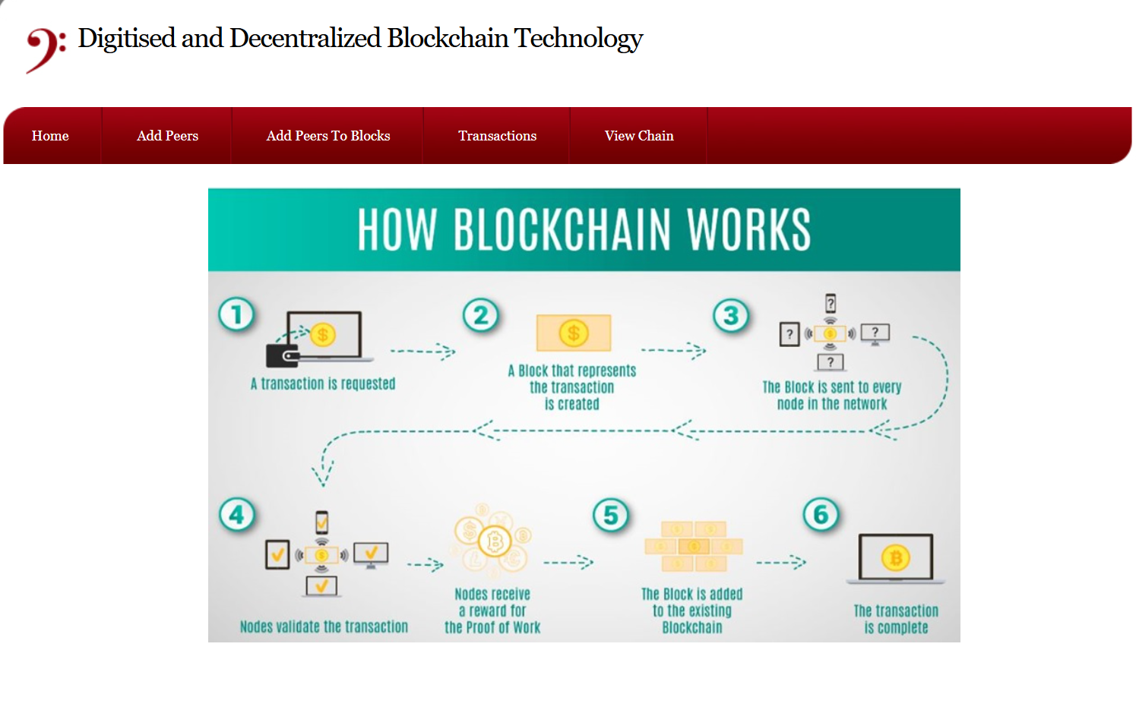
ARCHITECTURE

Slide 13
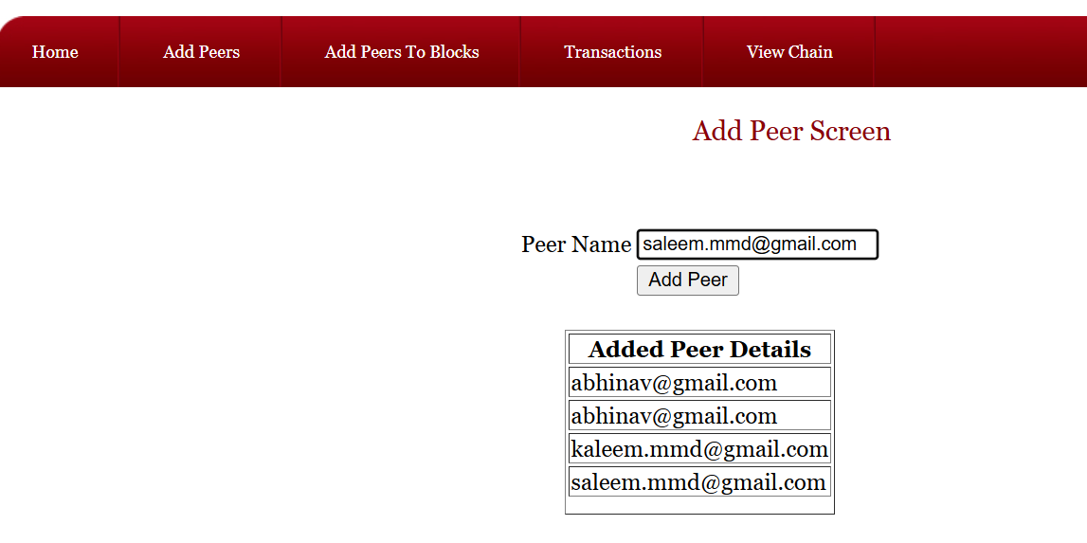
OUTPUT COSOLE: CREATING PEERS

Slide 14
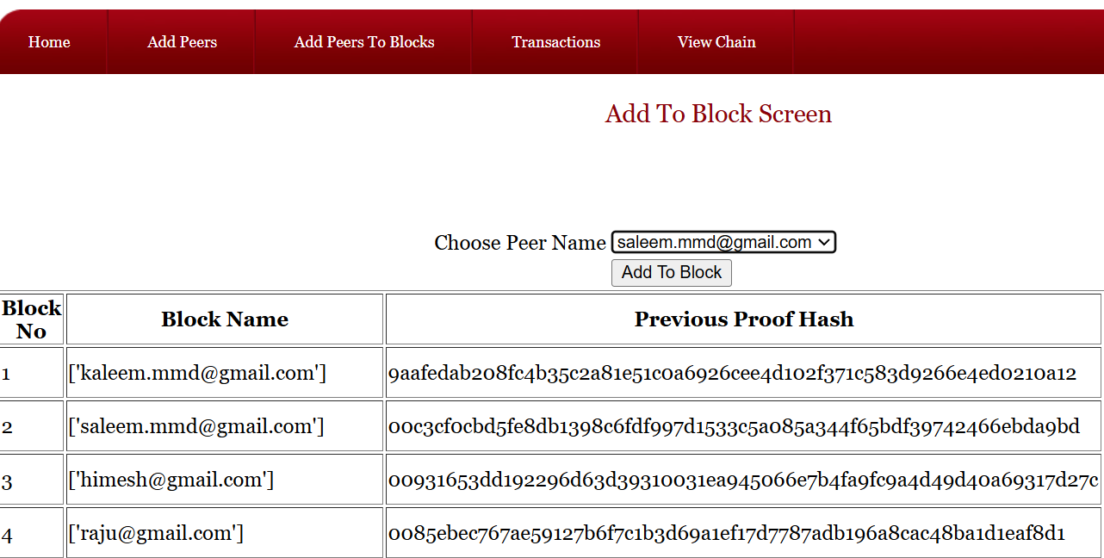
ADDING PEERS TO BLOCK

Slide 15
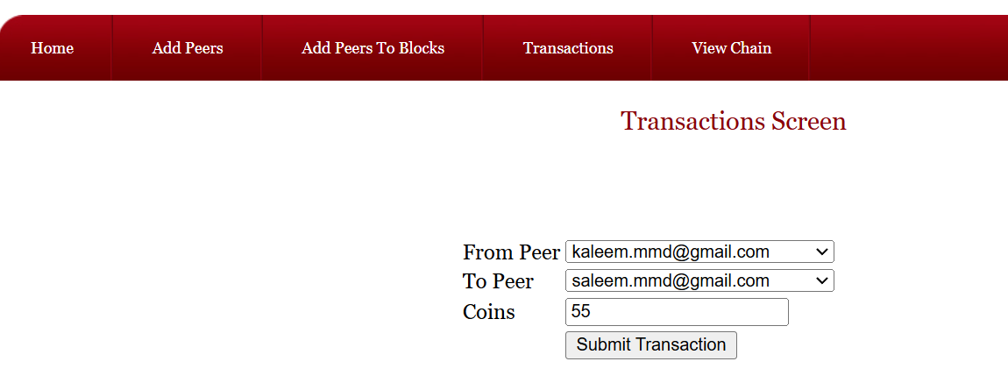
transAction

Slide 16
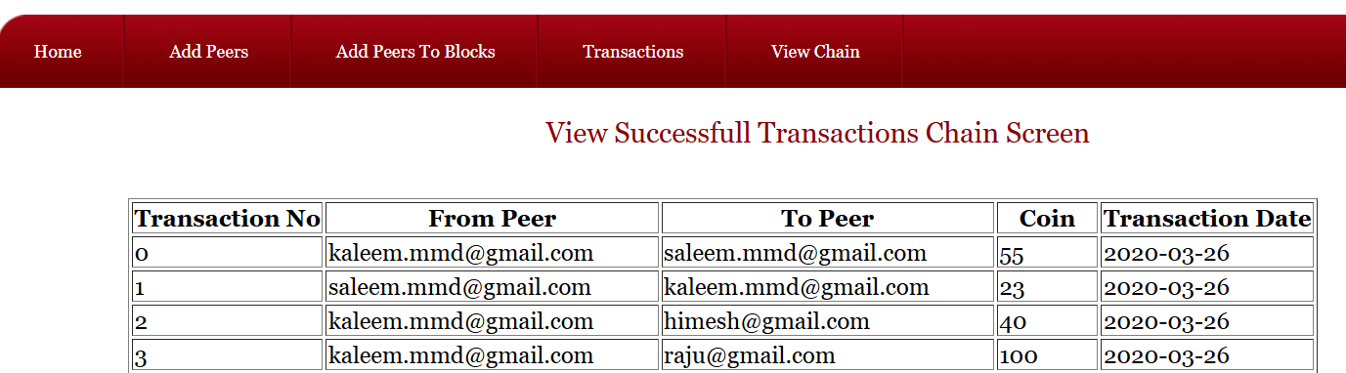
Transaction successful

Slide 17
CONCLUSION
We have proposed a system for electronic transactions without relying on trust.
We started with the usual framework of coins made from digital signatures, which provides strong control of ownership, but is incomplete without a way to prevent double-spending.
To solve this, we proposed a peer-to-peer network using proof-of-work to record a public history of transactions that quickly becomes computationally impractical for an attacker to change if honest nodes control a majority of CPU power.
The network is robust in its unstructured simplicity. Nodes work all at once with little coordination.
They do not need to be identified, since messages are not routed to any particular place and only need to be delivered on a best effort basis.

Slide 18
THANK YOU

